Slide 1


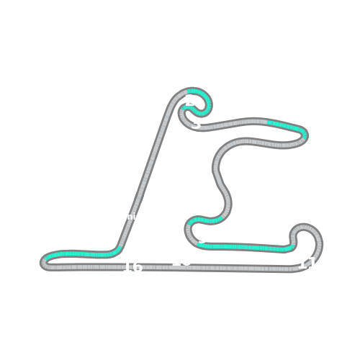


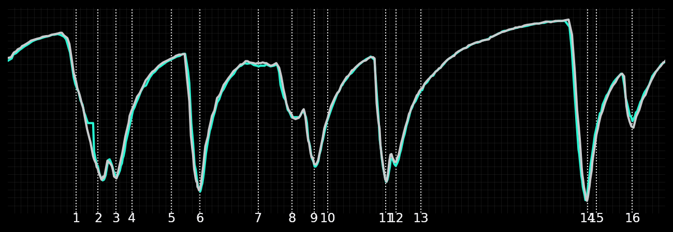
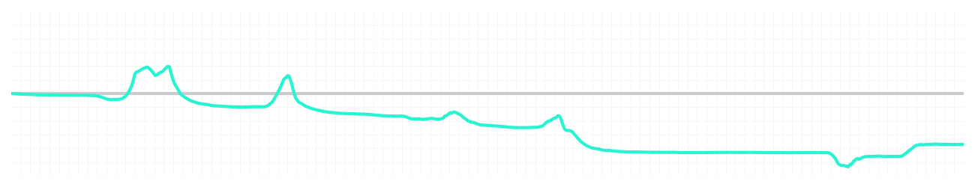
Chinese GP Sprint Quali Q3
Kimi Antonelli
Driver
George Russell
Driver
Lap Time
01:31.738
01:31.169
Lap Time
Sector 1
24.582
Speed Trap 1
281 kp/h
Speed Trap 1
282 kp/h
Sector 1
24.302
Sector 2
27.652
Speed Trap 2
278 kp/h
Gap
0.569
Gap
-0.569
Speed Trap 2
277 kp/h
Sector 2
27.425
Sector 3
39.504
Speed Final Line
271 kp/h
Corner Advantage
9/17
Corner Advantage
8/17
Speed Final Line
272 kp/h
Sector 3
39.442
FULL THROTTLE
56%
60%
FULL THROTTLE
HEAVY BREAKING
18%
20%
HEAVY BREAKING
%LAP TIME
CORNERING
26%
20%
CORNERING
%LAP TIME
SPEED
SPEED
DELTA TIME
DELTA TIME

Slide 2

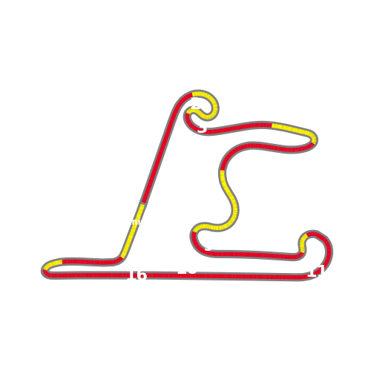


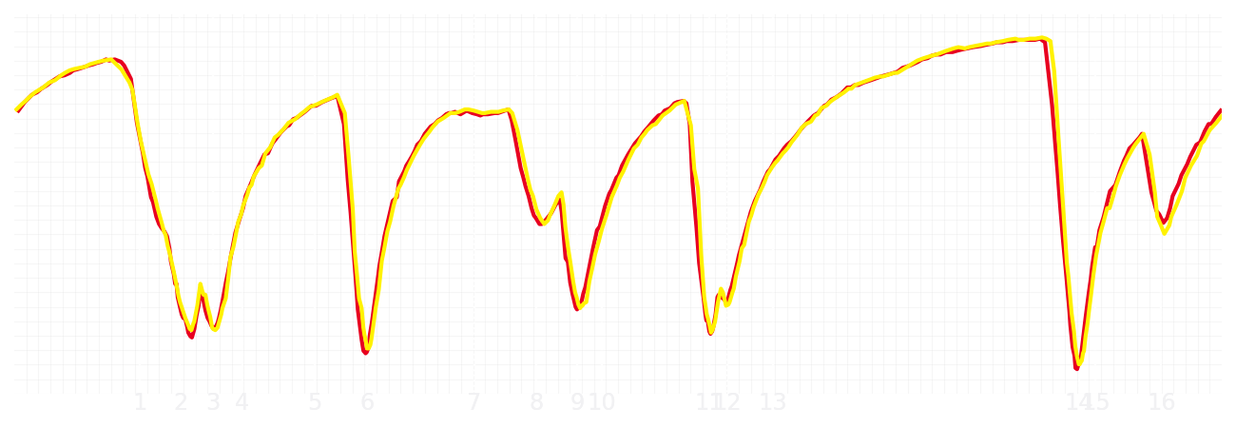
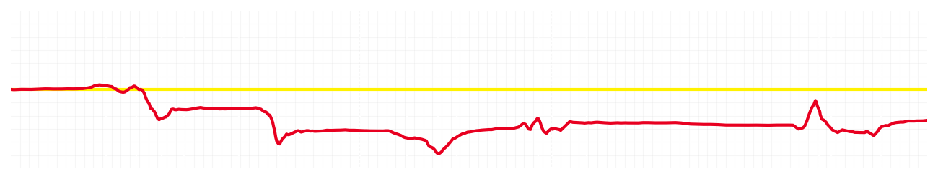
Chinese GP Sprint Quali Q3
Charles Leclerc
Driver
Lewis Hamilton
Driver
Lap Time
01:31.057
01:30.849
Lap Time
Sector 1
24.322
Speed Trap 1
283 kp/h
Speed Trap 1
283 kp/h
Sector 1
24.261
Sector 2
27.384
Speed Trap 2
279 kp/h
Gap
0.208
Gap
-0.208
Speed Trap 2
278 kp/h
Sector 2
27.249
Sector 3
39.351
Speed Final Line
272 kp/h
Corner Advantage
7/17
Corner Advantage
10/17
Speed Final Line
270 kp/h
Sector 3
39.339
FULL THROTTLE
58%
60%
FULL THROTTLE
HEAVY BREAKING
20%
23%
HEAVY BREAKING
%LAP TIME
CORNERING
22%
17%
CORNERING
%LAP TIME
SPEED
SPEED
DELTA TIME
DELTA TIME

Slide 3

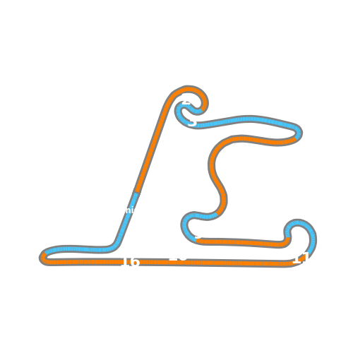


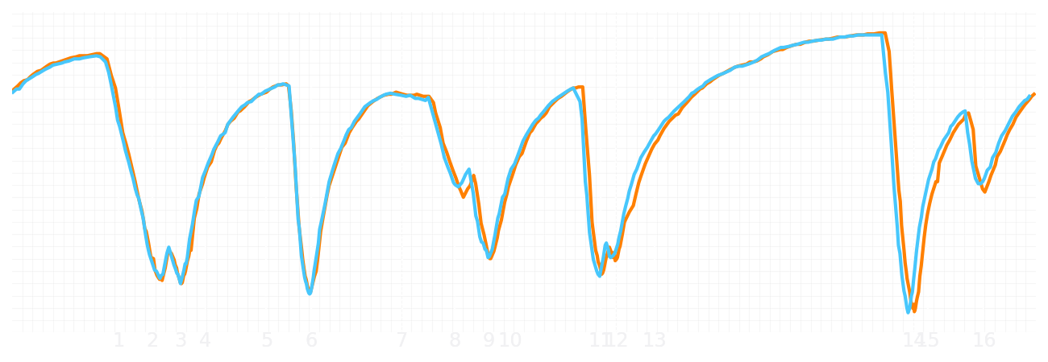
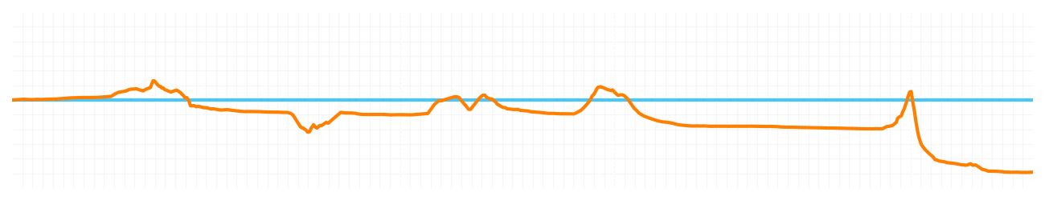
Chinese GP Sprint Quali Q3
Lando Norris
Driver
Oscar Piastri
Driver
Lap Time
01:31.393
01:30.929
Lap Time
Sector 1
24.293
Speed Trap 1
280 kp/h
Speed Trap 1
280 kp/h
Sector 1
24.297
Sector 2
27.440
Speed Trap 2
277 kp/h
Gap
0.464
Gap
-0.464
Speed Trap 2
276 kp/h
Sector 2
27.317
Sector 3
39.660
Speed Final Line
271 kp/h
Corner Advantage
11/17
Corner Advantage
6/17
Speed Final Line
269 kp/h
Sector 3
39.315
FULL THROTTLE
57%
60%
FULL THROTTLE
HEAVY BREAKING
20%
20%
HEAVY BREAKING
%LAP TIME
CORNERING
23%
20%
CORNERING
%LAP TIME
SPEED
SPEED
DELTA TIME
DELTA TIME

